Slide 1
ΠΑΝΕΠΙΣΤΗΜΙΟ ΑΙΓΑΙΟΥ ΣΧΟΛΗ ΕΠΙΣΤΗΜΩΝ ΤΗΣ ΔΙΟΙΚΗΣΗΣ ΤΜΗΜΑ ΔΙΟΙΚΗΣΗΣ ΕΠΙΧΕΙΡΗΣΕΩΝ
Εργαστήριο εφαρμογής νέων τεχνολογιών πληροφορικής και επικοινωνιών στην πολυμορφική και εξ αποστάσεως εκπαίδευση και κατάρτιση
Χίος, Δεκέμβριος 2013
IRIS

Slide 2
Περιεχόμενα
- Κύρια πεδία έρευνας του IRIS
- Κυριότερα έργα (ως Leader ή ως Partner)
- Δημοσιεύσεις
- Ενδεικτική παρουσίαση:
«Η Γέφυρα των Φιλικών»
«Νέα Μονή»
- Προσεχώς…

Slide 3
Κύρια πεδία έρευνας του IRIS
Τεχνολογίες πληροφορίας και επικοινωνίας στην πολυμορφική και εξ αποστάσεως εκπαίδευση
Διαχείριση ελεύθερου χρόνου (Leisure Time Management)
Διαχείριση Πολιτιστικού αποθέματος σε περιβάλλον επίσκεψης (Heritage Management in Recreational Learning Environments)
Τουριστική Ερμηνευτική (Visitor Centred Hermeneutics)
Ψηφιακά συστήματα διαχείρισης τουριστικού προορισμού (Destination Information Marketing and Management Systems)

Slide 4
Κυριότερα έργα (ως Leader ή ως Partner)
“HERODOT”: Tourism Uses of the Historic Environement. Transfer Know-How of best practices at Community Level Funding C.I Interreg, Strand IIIB, Measure 3.2 Budget 950.000€
TransInterpret II «Τransnational Quality Management in Heritage Interpretation». Funding C.I. Leader +: Strand 2. Measure 2.2. Transnational Cooperations Lead Partner LAG Suedschwarzwald and University of Freiburg. the Hellenic Regional Competent Centre and 16 Local Authority Groups in Germany, Italy, Switzerland, Spain and Greece. Budget 708.000 Euros
“METHEXIS” : Planning and Implementing a Destination Information Marketing and Management Systems for the tourism cluster of the Prefecture of Drama Funding C.I Leader+, Budget 70.000 €
HYDRORIZONS 1: Planning and Implementing a Destination Information Marketing and Management Systems for the tourism cluster A of the Prefecture of Ioannina, Funding C.I Leader+, Budget 12.000 €
HYDRORIZONS 2: Planning and Implementing a Destination Information Marketing and Management Systems for the tourism cluster B of the Prefecture of Ioannina, Funding C.I Leader+, Budget 17.000 €
…/…

Slide 5
Κυριότερα έργα (ως Leader ή ως Partner) συν.
The DELIGHT Project : Distance and e-Learning in Heritage Interpretation (DELIGHT: Distance E-Learning Interpretation Course on Greek Heritage Tourism)
“Society of the Friends. Secret Oaths in Western Greece”. A historical heritage trail through the Revolution in 1821. A tourism development plan to introduce domestic and foreign visitors to the centers that have prepared the Revolution of 1821 and established the modern State. Lead Partner: Development Agency of Aetolia. Funding C.I. Leader + 2006-2008, Strand 2. Measure 2.1 : Trans-regional Cooperation : Budget 63.500 Euros
“IKYDA 2004-2006”A comparative analysis of strengths and weaknesses, threats and unexploited heritage potential at tourism destinations”, Joint project of the Universities of Freiburg and of the Aegean, Programme Ikyda For The Promotion Of The Exchange And Scientific Cooperation Between Greece And Germany, IKY, DAAD. Budget 20.000 €

Slide 6
Δημοσιεύσεις (ενδεικτικός κατάλογος)
"Hydrorizons": A Supply Side Destination Information and - Marketing System. A Self-Governance Planning Process in Epirus, Greece; ERSA: Paris, France
Trans-regional co-operations in Western Greece: Synergies between tourism planning and local self-governance; ERSA: Paris, France
The convergence process in between demand and supply side: Planning for Visitor Access at World Heritage Site "NEA MONI" in Chios, Greece; Istituto Piaget: Vila Nova de Santo Andre, Portugal
Applying the interpretive planning process to promote local heritage in peripheral areas: Serving the visitor in the Highlands of Nafpaktia, Greece; Istituto Piaget: Vila Nova de Santo Andre, Portugal
Transinterpret II: Transnational Quality Management in heritage Interpretation within the framework of C.I. Leader+. The case of Greece, 46th European Congress of the Regional Science, Volos
Cognitive Processing of Information with Tourism Value: Improving Visitor Accessibility at World Heritage Site Nea Moni in Chios, Greece Val de Loire patrimoine mondial “ Frequenter Le Patrimoine : Accessibilité, Pratiques, Gestion”, Universite Angers

Slide 7
Δημοσιεύσεις (ενδεικτικός κατάλογος) συν.
A supply side Destination Information and Marketing system (DIMS): clustering tourism businesses at emerging destinations. the case of Epirus, Greece. Mediterreanean Conference on Information Systems (MCIS) Venice
Creating Quality Visitor Experiences: A Best Practice Management Case at The Palazzo Giustiniani in Chios, Greece, Paper Presented at the ICOMOS DEMHIST ANNUAL WORKSHOP Managing The Past For The Future. Sustaining Historic House Museums In The 21st Century, Valetta, Malta
Cognitive Processing of Information with Tourism Value: Improving Visitor Accessibility at World Heritage Site Nea Moni in Chios, Greece Val de Loire patrimoine mondial “ Frequenter Le Patrimoine : Accessibilité, Pratiques, Gestion”, Universite Angers
Best Practices in Heritage Management at regional level: Visitor centered Heritage Interpretation. A joint project of the Universities Freiburg i. Br. and of the Aegean"24th Eurochrie International Conference, Thessaloniki
Design and Delivery Model of a Distance E-Learning Course in Heritage Interpretation: the DELIGHT Project (Distance E-Learning Interpretation course on Greek Heritage Tourism) Paper presented at the Eurochrie International Conference
IKYDA 2004-2006: “Heritage Interpretation. A comparative analysis of strengths and weaknesses, threats and unexploited heritage potential at tourism destinations. A joint project Tagung Deutsch-Griechische Forschung, Berlin

Slide 8
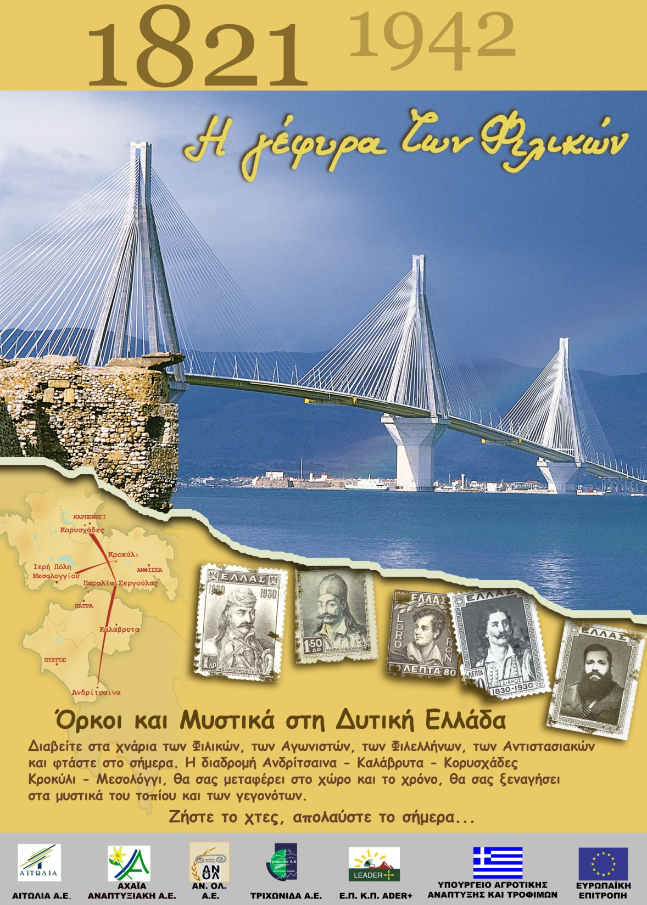

Slide 13
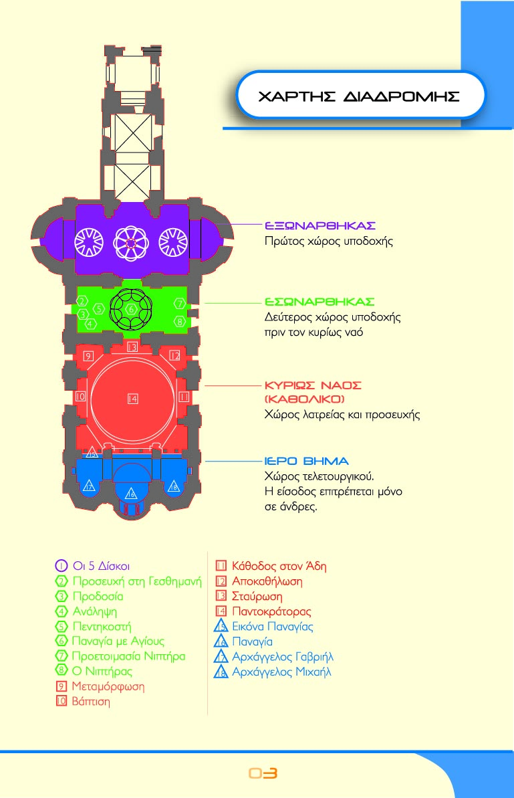

Slide 18
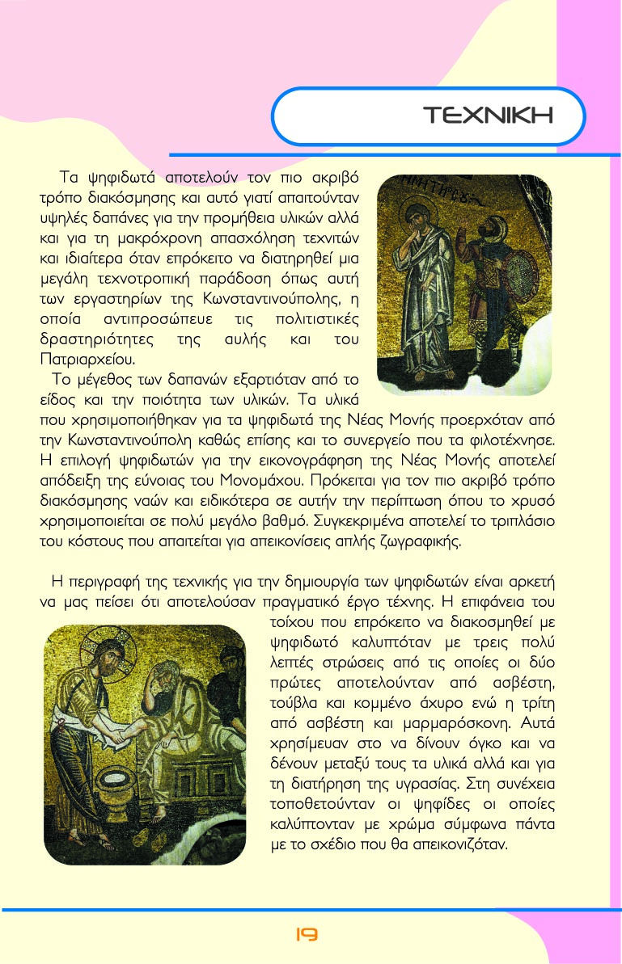

Slide 19
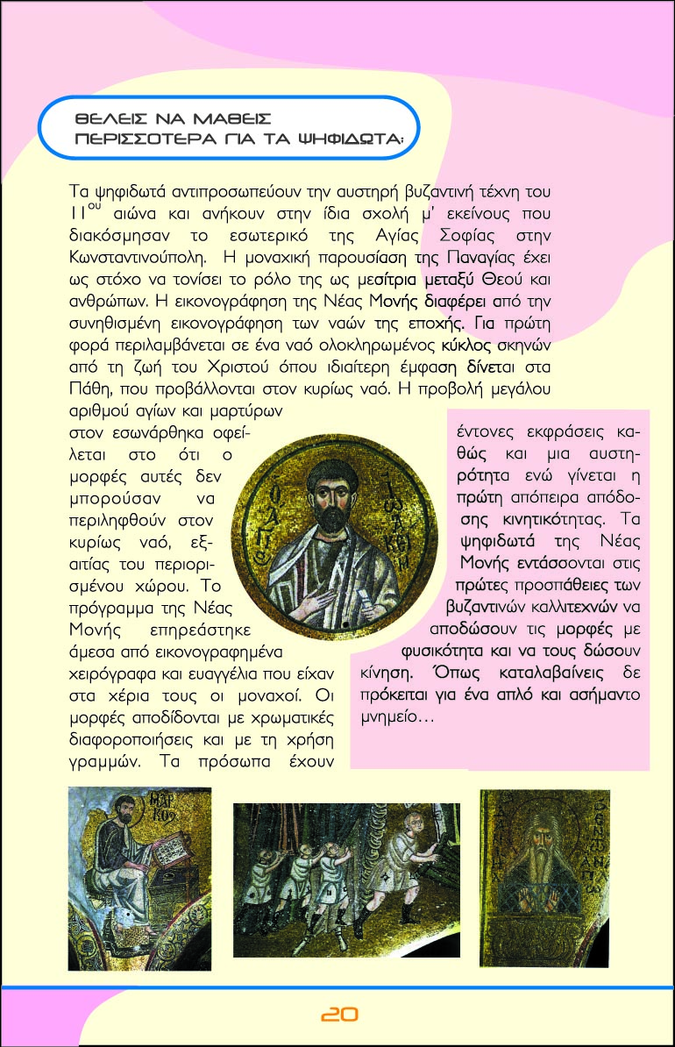

Slide 20
Προσεχώς…
Εξ αποστάσεως εκπαίδευση ή/και κατάρτιση σε περιοχές:
Διοίκησης Επιχειρήσεων
Ερμηνευτικών εργαλείων στον Τουρισμό
Έρευνα και εφαρμογή ολιστικών μοντέλων εξ αποστάσεως εκπαίδευσης:
e-Τμήμα
e- Πανεπιστήμιο
Ευχαριστώ για την προσοχή σας!

